Slide 1
Vehicle Counting & Detection

Slide 2
Description of the System
The system is able to achieve counting with a very good accuracy even in difficult scenarios linked to occlusions and/or presence of shadows. Whenever the vehicle crosses the line, automatically the count will be increase. The principle of the system is to use already installed cameras in road networks. We propose a robust segmentation algorithm that detects foreground pixels corresponding to moving vehicles. First, the approach models each pixel of the background with an adaptive Gaussian distribution. This model is coupled with a motion detection procedure, which allows correctly location of moving vehicles in space and time.

Slide 3
Features of the System
Detect and classify multiple vehicle types (truck, bus, bicycle, car) automatically and contactless.
Track multiple detected objects and count them in real-time as they pass a specific area. Aggregate counting data over time with custom logic and send it to third-party systems.
Edge AI allows full data privacy and robustness with on-device machine learning for image processing.

Slide 4
Objectives of the System
Traffic surveillance control: This application can be installed anywhere because it only requires a camera, some wires, and a computer to monitor, if traffic is heavy somewhere, an officer can monitor it from that location and send the information to the next toll officer so that they can be prepared ahead of time.
Monitor records: Because the cars are passing by in real time, some people find it difficult to capture all of the vehicles with them. It's not like no one is watching the video, therefore to get around this limitation, this program can be well-versed in order to achieve time-saving quality while also being automated.
Helps traffic police: A vehicle detection and counting system could be advantageous to traffic cops because it allows them to monitor everything from a single location, such as how many vehicles have crossed this toll and which vehicle.

Slide 5
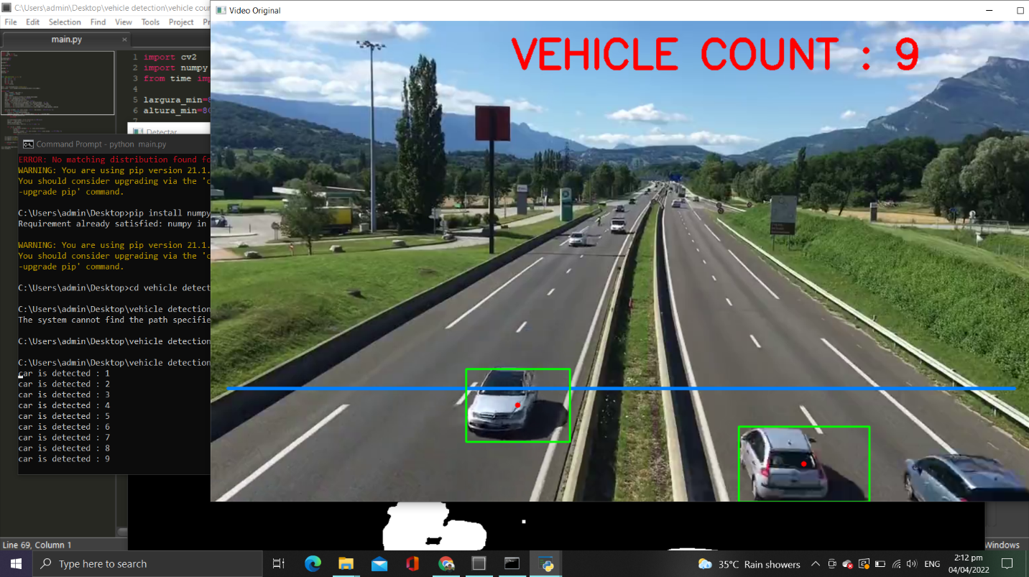
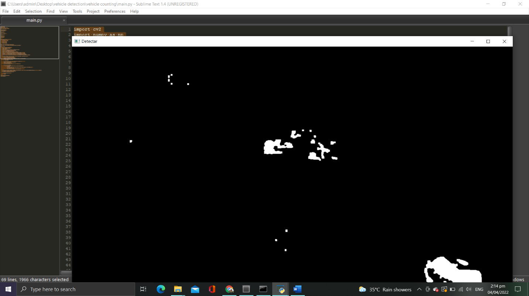

Slide 6
Developers of the System
Cabrera, Eliza
Mamaclay, Christian
Delos Pobres, Arjay
Santiago, Julian

